Slide 1
Propositional Logic
CSI 219 – Discrete Mathematics
Instructor: Minhajul Bashir

Slide 2
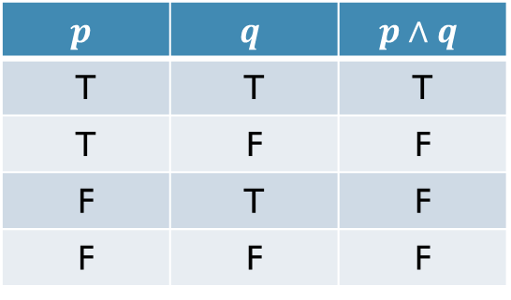
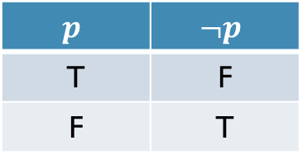
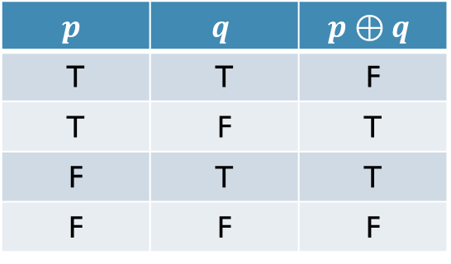
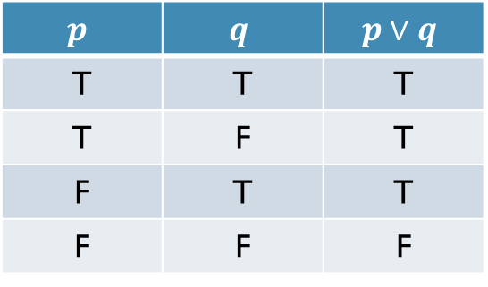
Recap
$$p$$ | $$¬p$$
T | F
F | T
$$p$$ | $$q$$ | $$p∧q$$
T | T | T
T | F | F
F | T | F
F | F | F
$$p$$ | $$q$$ | $$p∨q$$
T | T | T
T | F | T
F | T | T
F | F | F
$$p$$ | $$q$$ | $$p⊕q$$
T | T | F
T | F | T
F | T | T
F | F | F

Slide 3

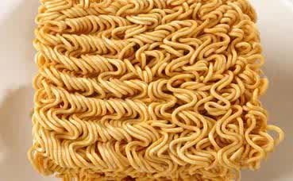
Conditional Statements
If Keka Ferdousi cooks a pickle,
she will put noodles in it.

Slide 4
What if someone else cook a pickle?
If Keka Ferdousi cooks a pickle, she will put noodles in it.

Slide 5

Conditional Statements
S/he might also put noodles in it!!! S/he might be a big fan of Keka Ferdousi :P
(Note: S/he also might not put noodles in it)

Slide 6
So when is the statement false??
If Keka Ferdousi cooks a pickle, she will put noodles in it.

Slide 7
Conditional Statements
X
The statement is false if she cooks a pickle, but does not put noodles in it.

Slide 8
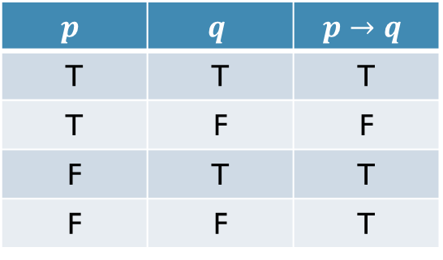
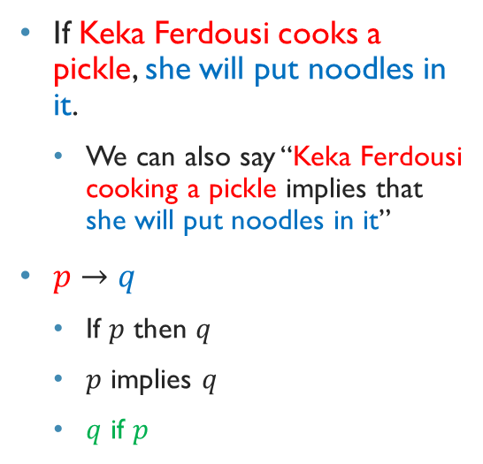
Conditional statements
If Keka Ferdousi cooks a pickle, she will put noodles in it.
We can also say “Keka Ferdousi cooking a pickle implies that she will put noodles in it”
$p→q$
If $p$ then $q$
$p$ implies $q$
$q$ if $p$
$$p$$ | $$q$$ | $$p→q$$
T | T | T
T | F | F
F | T | T
F | F | T

Slide 9
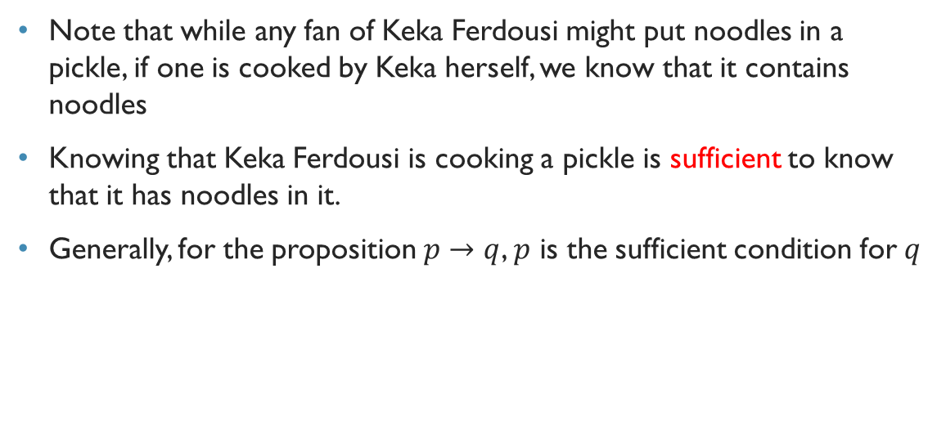
Sufficient condition
Note that while any fan of Keka Ferdousi might put noodles in a pickle, if one is cooked by Keka herself, we know that it contains noodles
Knowing that Keka Ferdousi is cooking a pickle is sufficient to know that it has noodles in it.
Generally, for the proposition $p→q$, $p$ is the sufficient condition for $q$

Slide 10
Let us now assume that there is no fan of Keka Ferdousi!!!
Since there is no fan, no one would put noodles in a pickle ☺

Slide 11
Necessary condition
Only if Keka Ferdousi cooks a pickle,
she will put noodles in it.

Slide 12
But can she cook it without noodles?
Apparently, she can. Trust me!

Slide 13
Necessary Condition
X
If Keka Ferdousi does not put noodles in the pickle, it does NOT violate our original statement, since she might also put beef in it :P

Slide 14
So when is the statement false?
Only if Keka Ferdousi cooks a pickle, she will put noodles in it.

Slide 15
Necessary condition
If someone else puts noodles in his/her pickle.

Slide 16
Necessary condition
Note that while Keka Ferdousi might put anything in her pickle, only she can put noodles in it.
In another word, for a pickle to contain noodles, it is necessary that it is cooked by Keka Ferdousi.

Slide 17
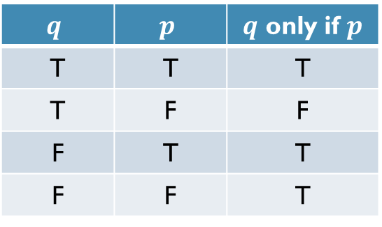

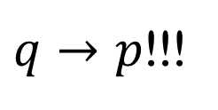
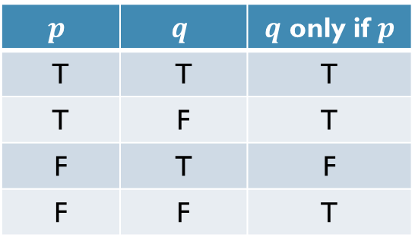
Necessary condition
Only if Keka Ferdousi cooks a pickle, she will put noodles in it.
Only if $p$ then $q$, or $q$ only if $p$
$$p$$ | $$q$$ | $q$ only if $p$
T | T | T
T | F | T
F | T | F
F | F | T
$$q$$ | $$p$$ | $q$ only if $p$
T | T | T
T | F | F
F | T | T
F | F | T
$q→p$!!!

Slide 18
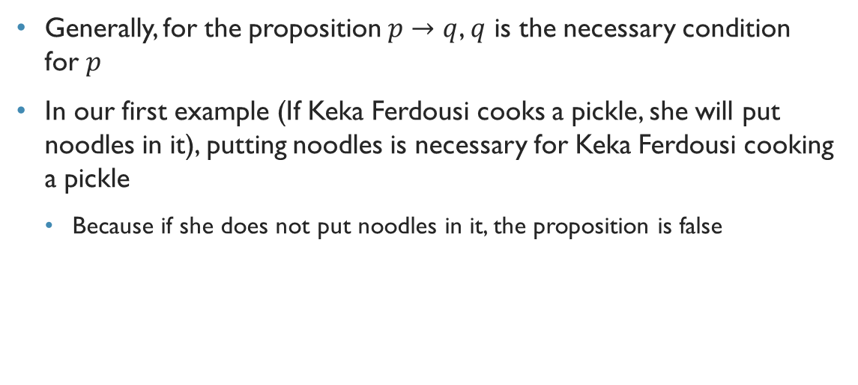
Necessary condition
Generally, for the proposition $p→q$, $q$ is the necessary condition for $p$
In our first example (If Keka Ferdousi cooks a pickle, she will put noodles in it), putting noodles is necessary for Keka Ferdousi cooking a pickle
Because if she does not put noodles in it, the proposition is false

Slide 19
Let’s be a bit more realistic
If Keka Ferdousi is cooking a pickle, she will put noodles in it.
Anyone might put noodles in a pickle.
Only if Keka Ferdousi is cooking a pickle, she will put noodles in it.
She might also put something else.
What if we want to make sure only Keka Ferdousi puts noodles in a pickle, and she does not put anything else??

Slide 20
Keka Ferdousi will cook a pickle if and only if she puts noodles in it.

Slide 21
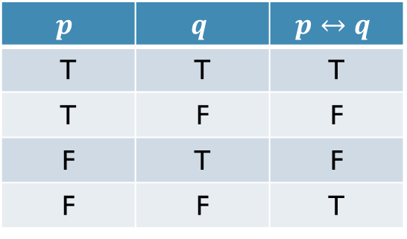
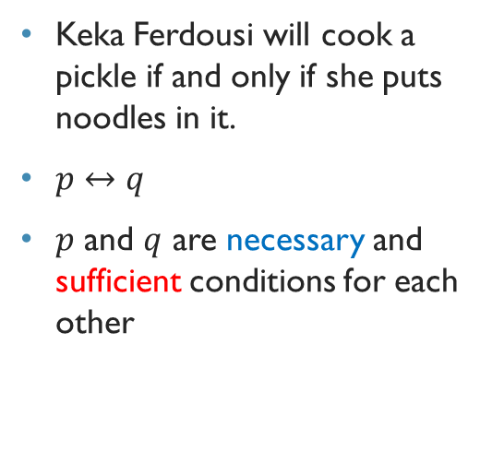
Biconditional statement
Keka Ferdousi will cook a pickle if and only if she puts noodles in it.
$p↔q$
$p$ and $q$ are necessary and sufficient conditions for each other
$$p$$ | $$q$$ | $$p↔q$$
T | T | T
T | F | F
F | T | F
F | F | T

Slide 22

Converse, Contrapositive and Inverse
If Keka Ferdousi cooks a pickle, she will put noodles in it.
Converse: If Keka Ferdousi puts noodles in a pickle, she will cook the pickle.
Contrapositive: If Keka Ferdousi does not put noodles in a pickle, she will not cook the pickle.
Inverse: If Keka Ferdousi does not cook a pickle, s/he will not put noodles in it.
Which of these are equivalent?
$p→q$
$q→p$
$¬q→¬p$
$¬p→¬q$

Slide 23
Logical Equivalence

Slide 24
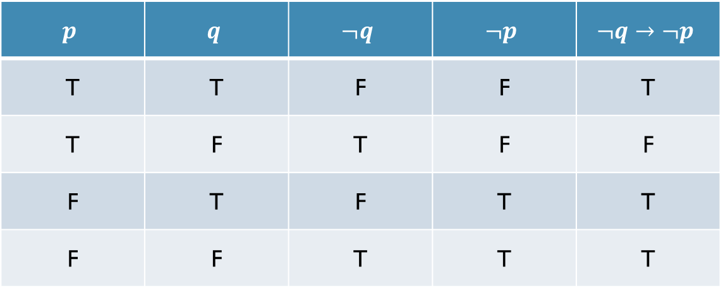
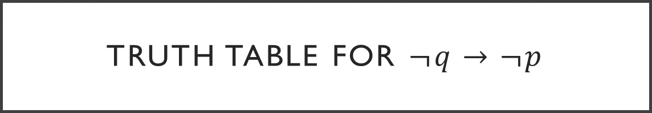
Truth table for $¬q→¬p$
$$p$$ | $$q$$ | $$¬q$$ | $$¬p$$ | $$¬q→¬p$$
T | T | F | F | T
T | F | T | F | F
F | T | F | T | T
F | F | T | T | T

Slide 25
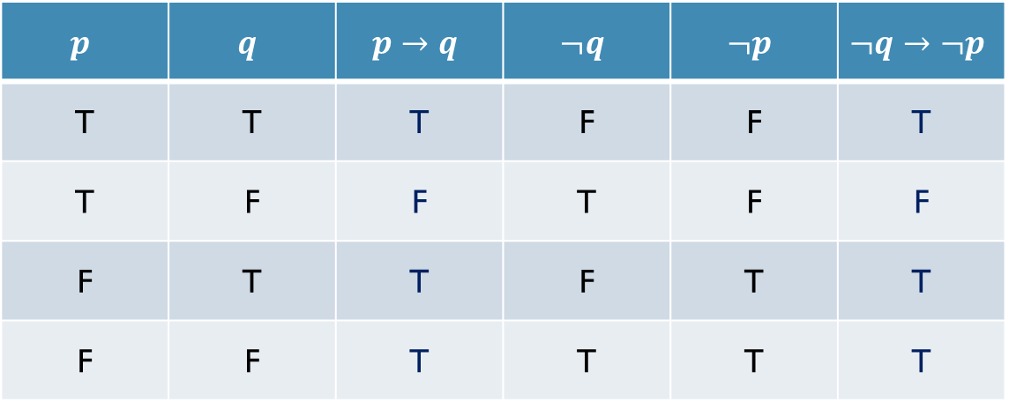
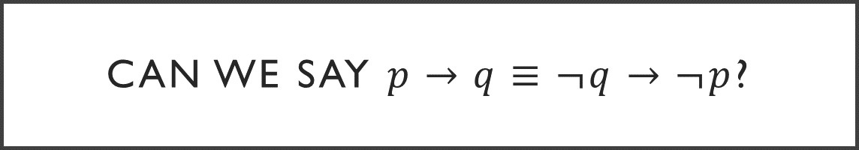
Can we say $p→q≡¬q→¬p$?
$$p$$ | $$q$$ | $$p→q$$ | $$¬q$$ | $$¬p$$ | $$¬q→¬p$$
T | T | T | F | F | T
T | F | F | T | F | F
F | T | T | F | T | T
F | F | T | T | T | T
Equivalent!!!

